Slide 1
Professor & Lawyer
Puttu Guru Prasad
B.Com., M.Com., M.Phil., M.B.A., PGDFTM., AP.SET., M.Phil., DRMS., L.L.B., ICFAI TMF., DIRM., L.L.M., Pre PhD (PhD)from JNTUK., Topper Domain Topper & 30th Batch Topper at ICFAI -2009 Training for Management Faculty
“Diploma in Psychology from YALE University”
MHRDI’s 'Institution's Innovation Council (IICs)Ambassador
NSS Certified Program Officer, (A.U) ICFAI UNIVERSITY Trained Senior Faculty
Senior Faculty for Business Studies, Economics, Accounts
Head, Board of Administration & Management Science,
BHAGAVAD GITA & CLAT & IPMAT Program Coordinator,
S&H Department, VIVA-VVIT, Nambur,
My Blog: puttuguru.blogspot.in
My Web Site: https://gurublogs.wixsite.com/guru
93 94 96 98 98, 9885 96 36 36, 807 444 9539,

Slide 2
THE INDIAN CONSTITUTION: IMPORTANT THINGS YOU SHOULD KNOW
Professor & Lawyer Puttu Guru Prasad

Slide 3
UNIT-I
Introduction to Indian Constitution: “Constitution” meaning of the term, Indian Constitution – Sources and constitutional history, Features - Citizenship, Preamble, Fundamental Rights and Duties, Directive Principles of State Policy.
UNIT-II
Union Government and its Administration Structure of the Indian Union: Federalism, Centre-State relationship, President: Role, power and position, PM, and Council of ministers, Cabinet and Central Secretariat, Lok Sabha, Rajya Sabha, The Supreme Court and High Court: Powers and Functions;
UNIT-III
State Government and its Administration Governor - Role and Position - CM and Council of Ministers, State Secretariat: Organization, Structure, and Functions
UNIT-IV
Local Administration - District’s Administration Head - Role and Importance, Municipalities -Mayor and role of Elected Representative - CEO of Municipal Corporation Panchayats: Functions PRI: Zila Panchayat, Elected officials and their roles, CEO Zila Panchayat: Block level Organizational Hierarchy - (Different departments), Village level - Role of Elected and Appointed officials - Importance of grass root democracy
UNIT-V
Election Commission: Election Commission- Role of Chief Election Commissioner and Election Commissioner ate State Election Commission: Functions of Commissions for the welfare of SC/ST/OBC and women

Slide 4
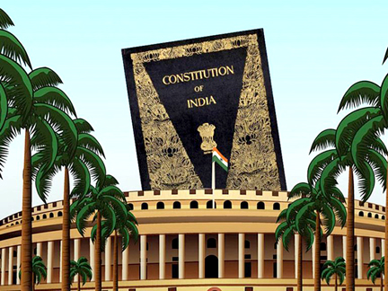

Slide 5
Introduction
Every year on 26th November, Constitution day is celebrated in the country.
Constitution Day (or Samvidhan Divas), also known as National Law Day, is celebrated to commemorate the adoption of the Constitution of India.
On 26 November 1949, the Constituent Assembly of India adopted the Constitution of India, and it came into effect on 26 January 1950.
The Government of India declared 26 November as Constitution Day on 19 November 2015 by a gazette notification.
The year 2015 was the 125th birth anniversary of Dr. B.R Ambedkar, who had chaired the drafting committee of the Constituent Assembly.
He played a pivotal role in the drafting of the Constitution. Previously this day was celebrated as Law Day.
This is a day to express gratitude to the makers of our Constitution and to reiterate our commitment to building the India of their dreams.”

Slide 6
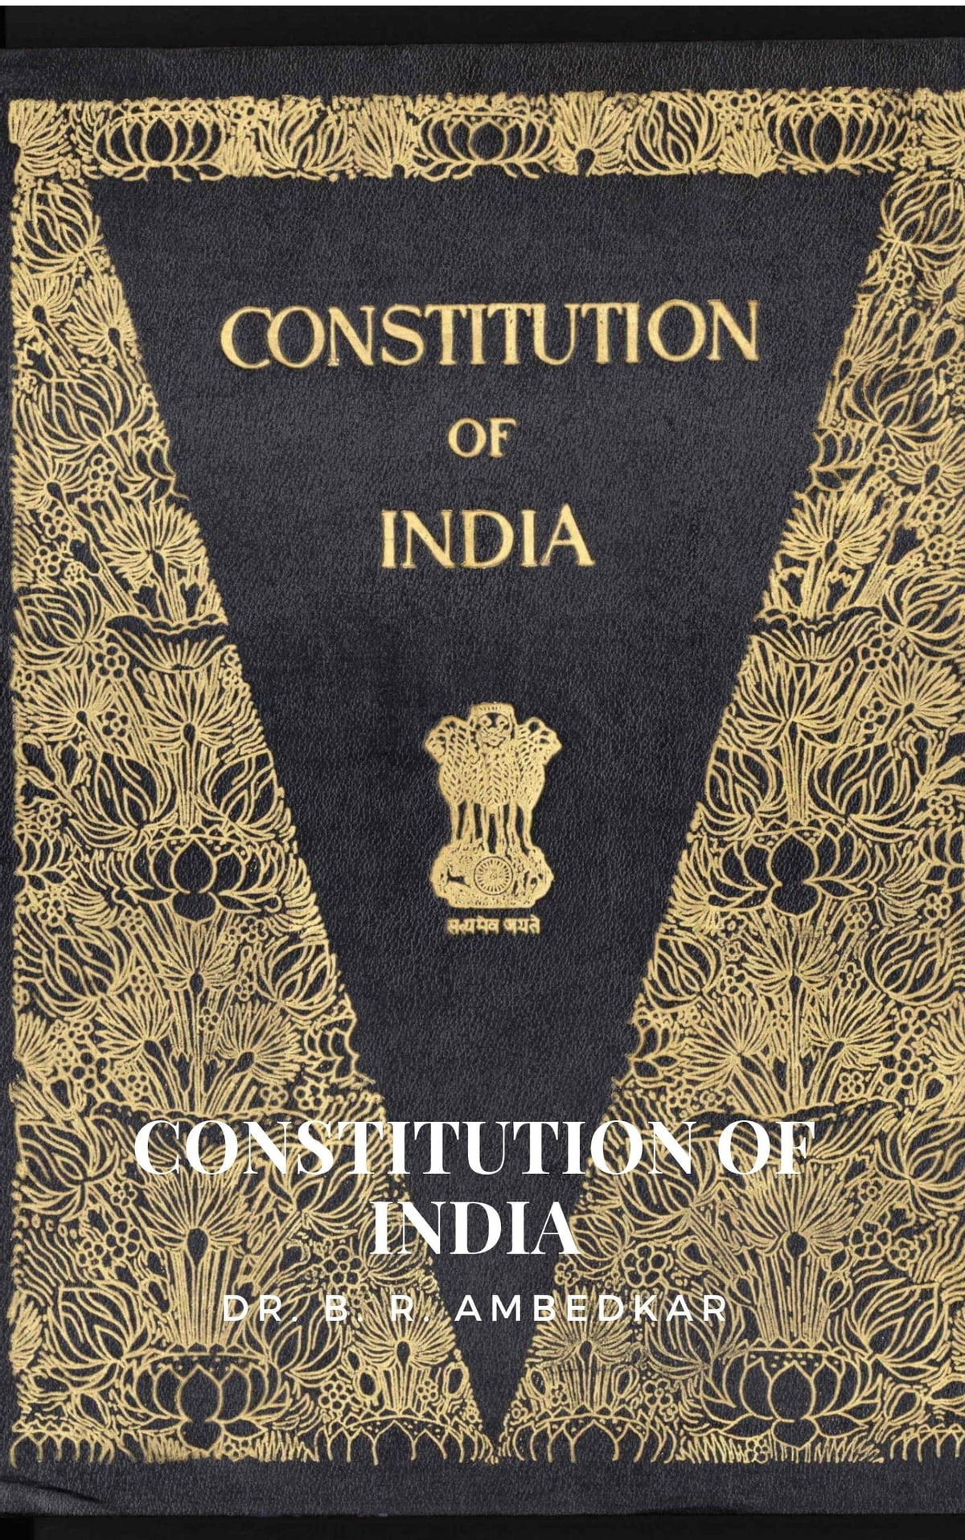
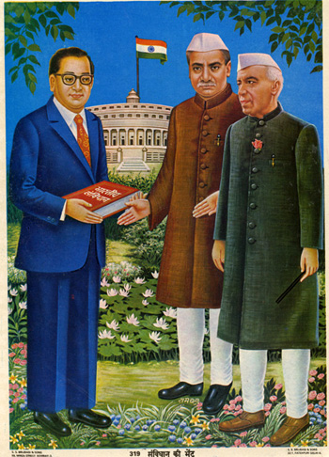

Slide 7
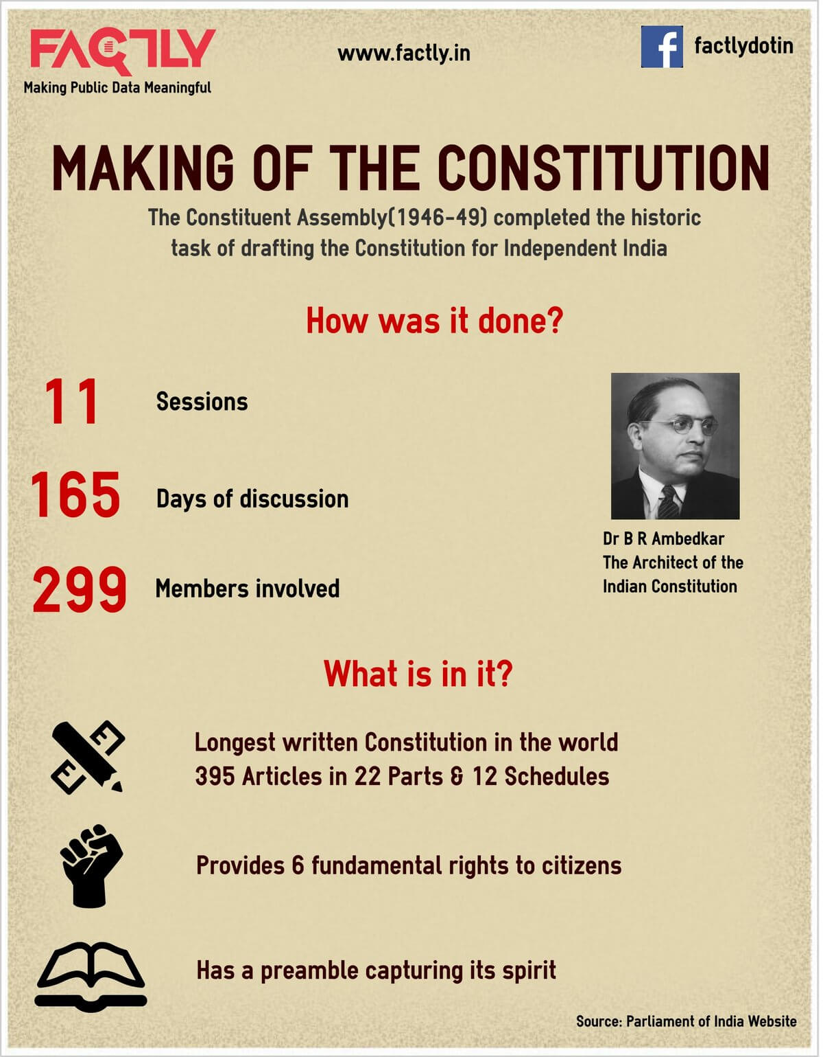
Meaning of Constitution
The term constitution comes from French from the Latin word constitutio, used for regulations and orders, such as imperial enactments.
A constitution is primarily a set of rules and principles specifying how a country should be governed, how power is distributed and controlled, and what rights citizens possess. It can also be said as the fundamental law of the country.

Slide 8
Why do we need a Constitution?
Almost every aspect of our lives is governed by a set of rules. Think of your games; almost everyone has their own specific regulations; your schools have certain rules that you have to follow.
Adults are not exempt from rules; workplaces have them. Some are imposed by custom and tradition.
Similarly, society also needs certain rules so that people can live together in a safe manner.
These are called Laws and are made by legislatures like our Parliament. The Constitution is the supreme law of the country and it contains laws concerning the government and its relationships with the people.
This quote by Patrick Henry, an American lawyer and politician, sums up the power of a Constitution best: “The Constitution is not an instrument for the government to restrain the people; it is an instrument for the people to restrain the government.”

Slide 9
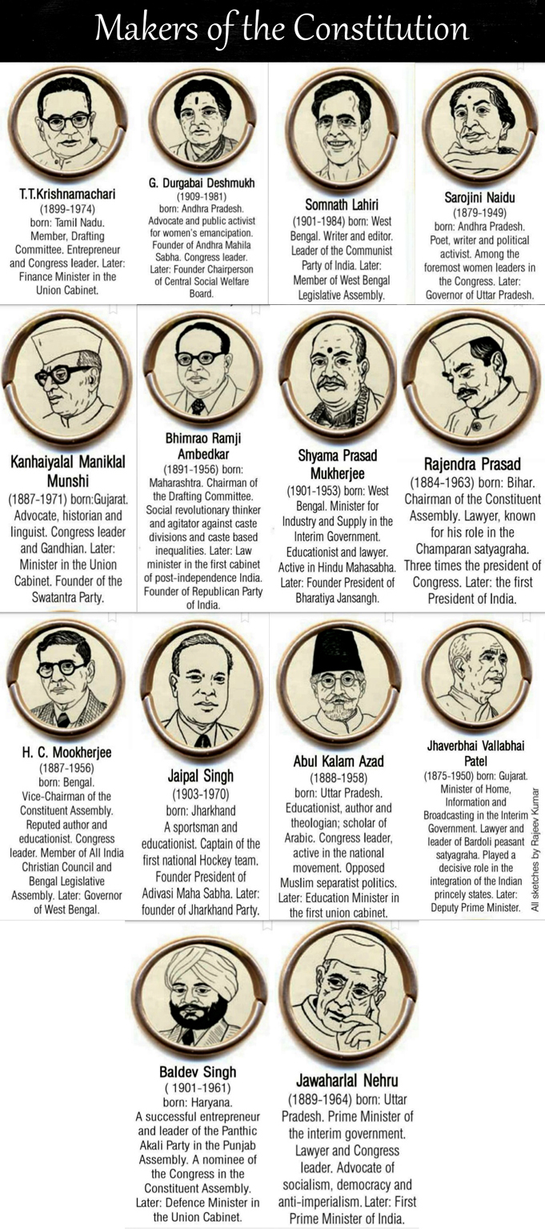
Sovereign
The term Sovereign which is proclaimed by the Preamble means that India has its own independent authority and it is not a dominion of any other external power.
In the country, the legislature has the power to make laws which are subjected to certain limitations.*

Slide 10
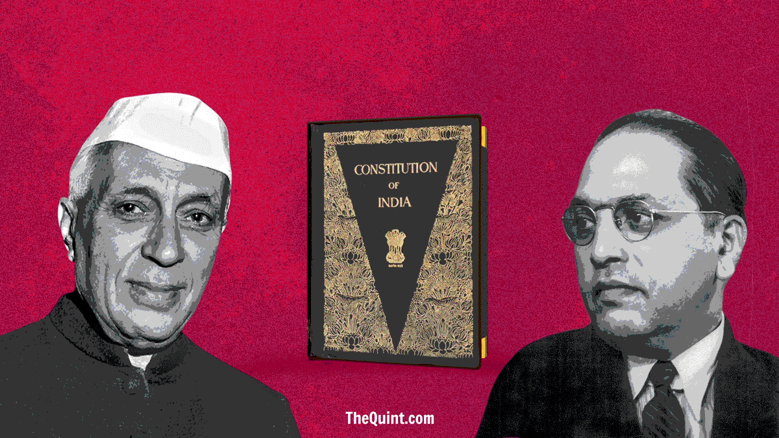

Slide 11
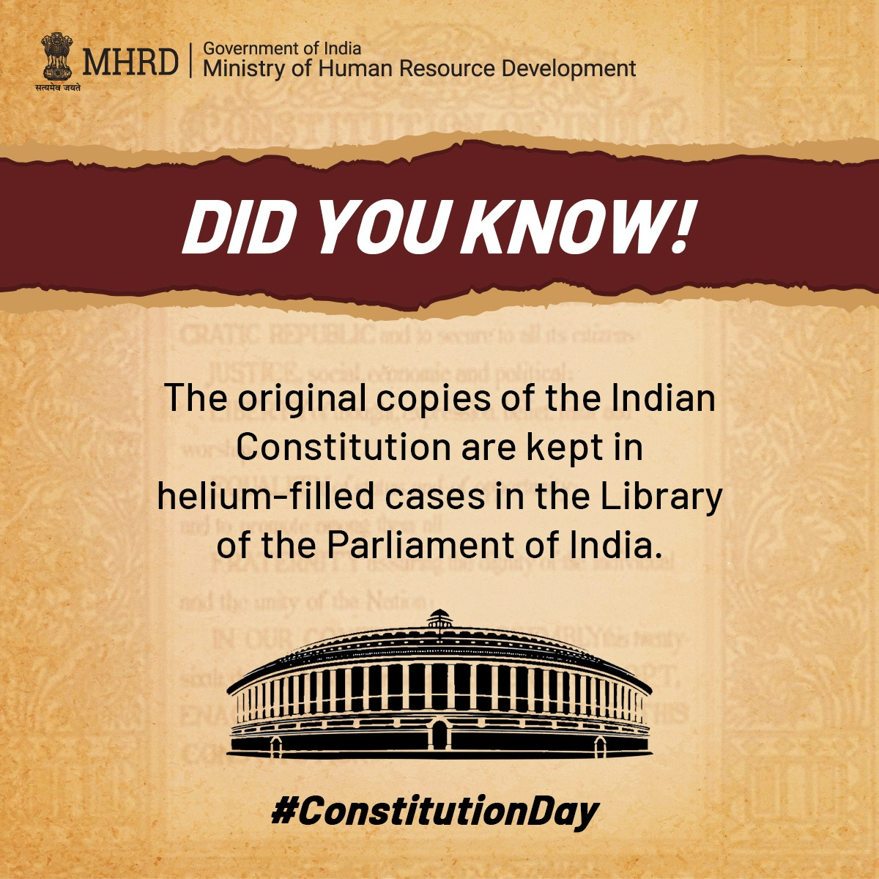
The original Constitution of India was handwritten by Prem Behari Narain Raizada in a flowing italic style with beautiful calligraphy. The Constitution was published in Dehradun and photolithographed by the Survey of India. Each page was uniquely decorated by artists from Shantiniketan including Beohar Rammanohar Sinha and Nandalal Bose.

Slide 12

PREAMBLE
WE, THE PEOPLE OF INDIA, having solemnly resolved to constitute India into a SOVEREIGN SOCIALIST SECULAR DEMOCRATIC REPUBLIC and
to secure to all its citizens:
JUSTICE, social, economic and political;
LIBERTY of thought, expression, belief, faith and worship;
EQUALITY of status and of opportunity and to promote among them all;
FRATERNITY assuring the dignity of the individual and the unity and integrity of the Nation;
IN OUR CONSTITUENT ASSEMBLY this twenty sixth day of November, 1949, do HEREBY ADOPT, ENACT AND GIVE TO OURSELVES THIS CONSTITUTION.

Slide 13
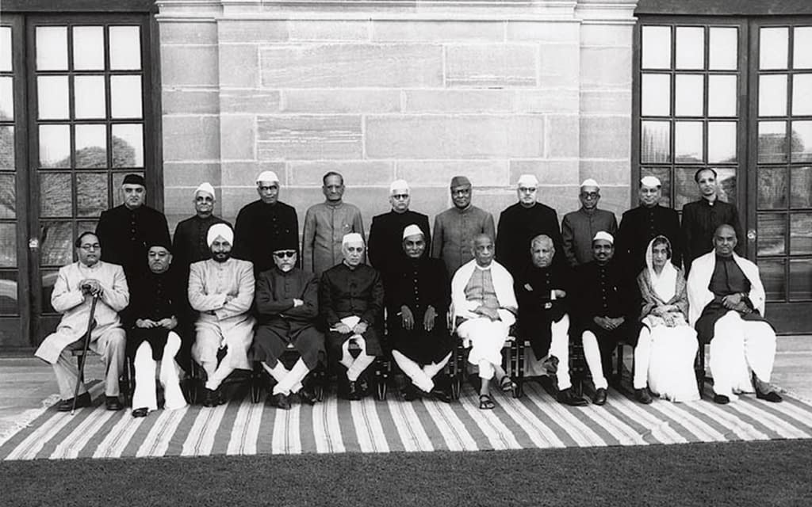
Formation of the
Constituent Assembly

Slide 14
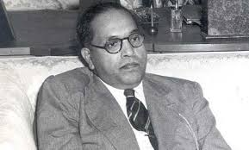

BR. Ambedkar
The Chief architect of Indian Constitution

Slide 15
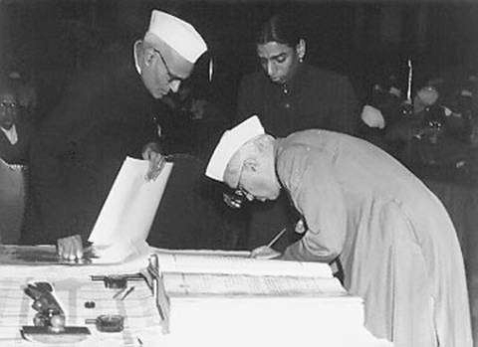

ARCHITECTS OF THE INDIAN CONSTITUTION
Pt. Nehru signing on the Constitution

Slide 16
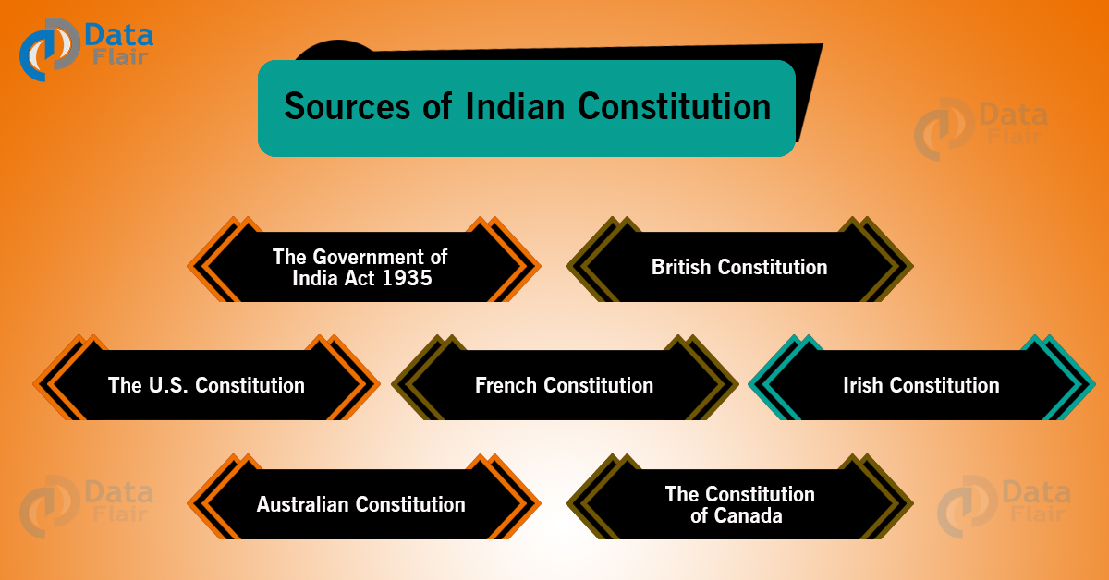

Slide 17
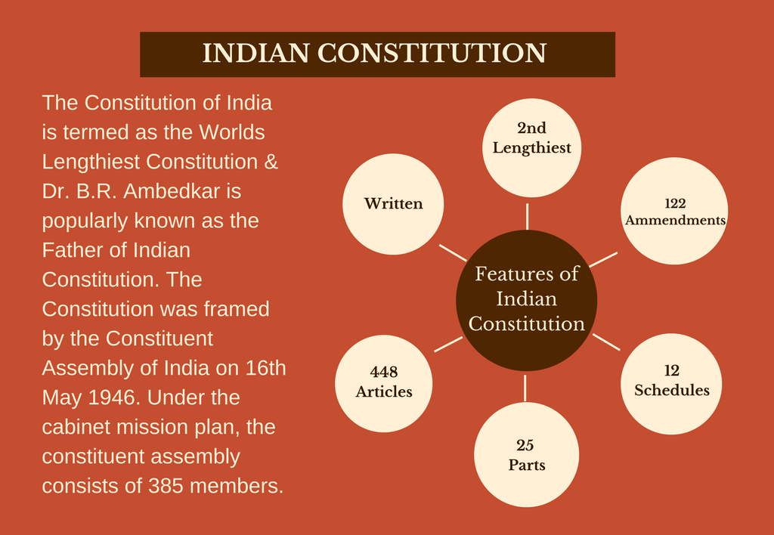

Slide 18
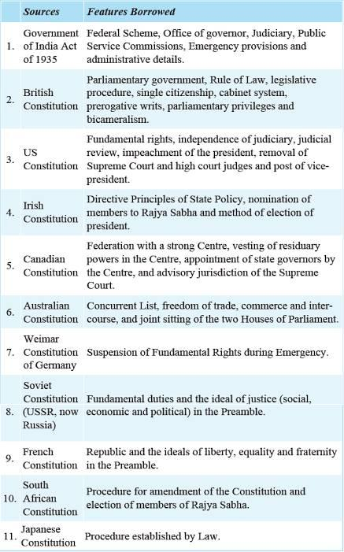

Slide 20
Background of Constituent Assembly of India
India was still under British rule when the Constituent Assembly was established, following negotiations between Indian leaders and members of the 1946 Cabinet Mission to India from the United Kingdom.
Provincial assembly elections were held in early 1946. Constituent Assembly members were elected indirectly by members of the newly elected provincial assemblies, and initially included representatives for those provinces that formed part of Pakistan (some of which are now in Bangladesh).
The Constituent Assembly had 389 representatives, including fifteen women. (which declined to 299 after the partition)

Slide 21
Timeline of Formation of 'The Constitution of India'
9 December 1946: Formation of the Constituent Assembly (demanding a separate state, the Muslim League boycotted the meeting)
11 December 1946: President Appointed – ⁣Rajendra Prasad, vice-chairman Harendra Coomar Mookerjee and constitutional legal adviser B. N. Rau (initially 389 members in total, which declined to 299 after partition. Out of 389, 292 were from government provinces, 4 from chief commissioner provinces and 93 from princely states)
13 December 1946: An 'Objective Resolution' was presented by Jawaharlal Nehru, laying down the underlying principles of the constitution, which later became the Preamble of the constitution.
22 January 1947: Objective resolution unanimously adopted.
22 July 1947: National flag adopted.
15 August 1947: Achieved independence. India split into the Dominion of India and the Dominion of Pakistan.
29 August 1947: Drafting Committee was appointed, with Dr. B. R. Ambedkar as the chairman. Other 6 members of the Committee
16 July 1948: Along with Harendra Coomar Mookerjee, V. T. Krishnamachari was also elected as the second vice-president of the Constituent Assembly.
26 November 1949: 'Constitution of India' passed and adopted by the assembly.
24 January 1950: Last meeting of the Constituent Assembly. 'Constitution of India' (with 395 articles, 8 schedules, 22 parts) was signed and accepted by all.
26 January 1950: The 'Constitution of India' came in to force after 2 years, 11 months and 18 Days, at a total expenditure of ₹6.4 million to finish.

Slide 22
The Preamble: What does it say, and what does it mean?
A preamble is an introductory statement in a document that explains the document’s philosophy and objectives.
In a Constitution, it presents the intention of its framers, the history behind its creation, and the core values and principles of the nation.
The Preamble basically describes the source, nature, ideology, goals and objectives of the Constitution.
The ideals behind the Preamble to India’s Constitution were laid down by Jawaharlal Nehru’s Objectives Resolution, adopted by the Constituent Assembly on January 22, 1947.
Although not enforceable in court, the Preamble states the objects of the Constitution, and acts as an aid during the interpretation of Articles when language is found ambiguous.

Slide 23
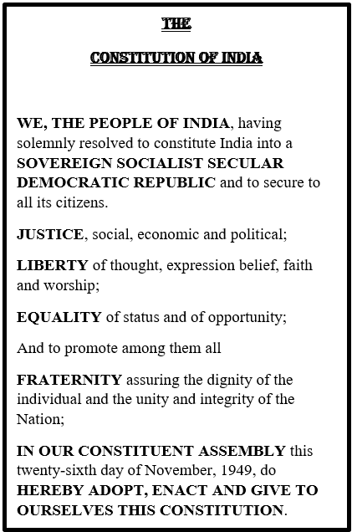
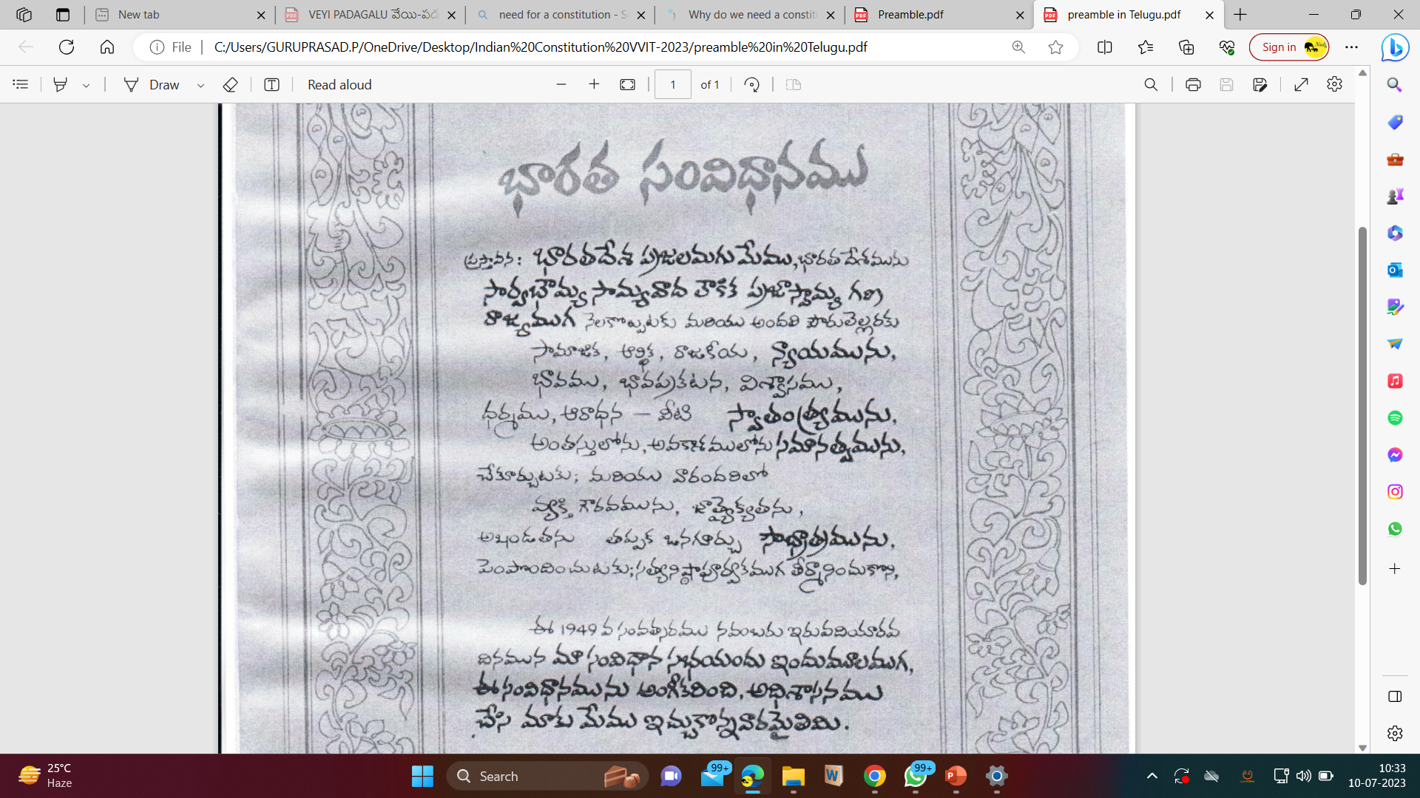

Slide 24
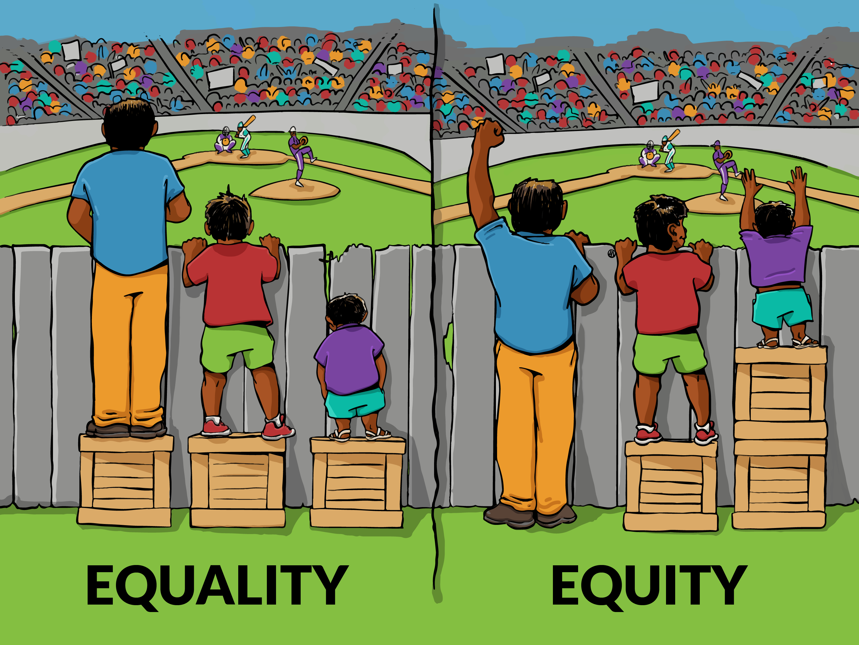

Slide 25
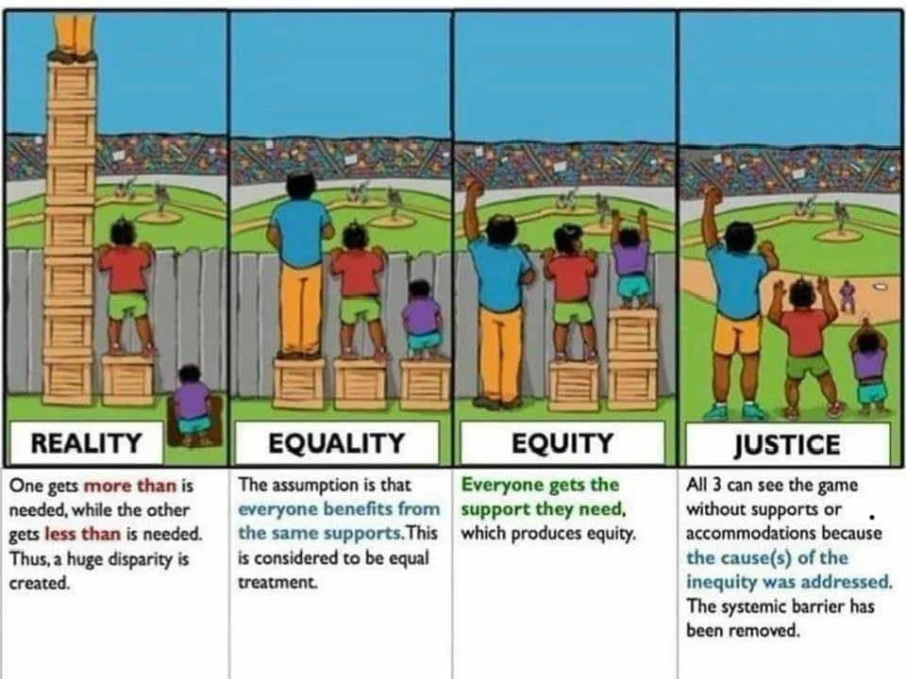

Slide 26
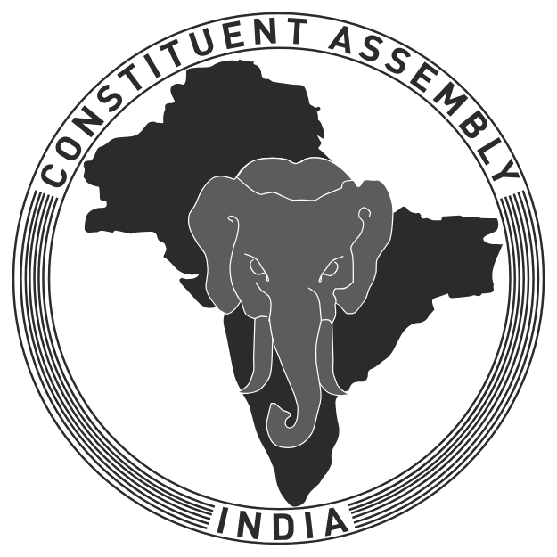
అఖండ భారత దేశం

Slide 27
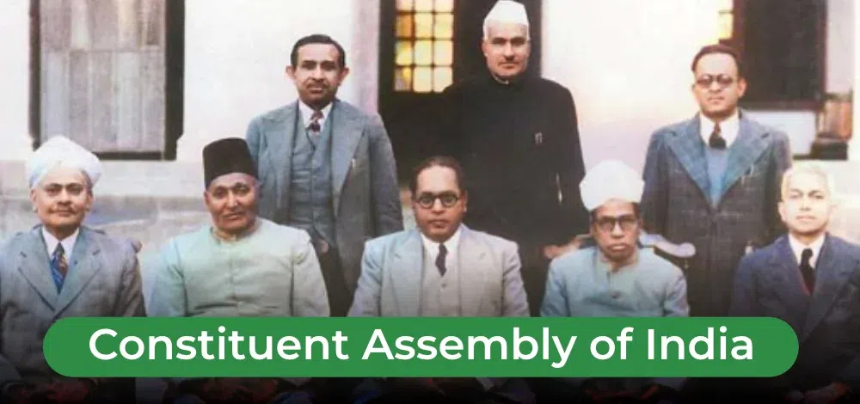
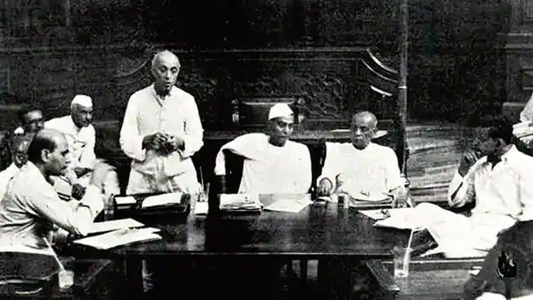
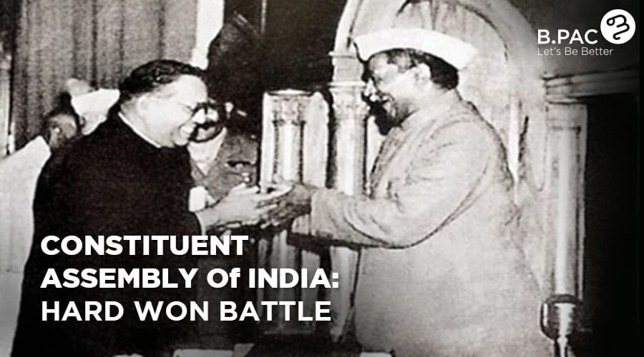

Slide 28
Before going to understand what is a Constitution, First, We will try to understand what is a RULE? and its implications
Rules are meant for everyone.
They apply equally to all.
Disobeying the rules leads to punishment.
There is no discrimination in punishments for breaking the rules.

Slide 29
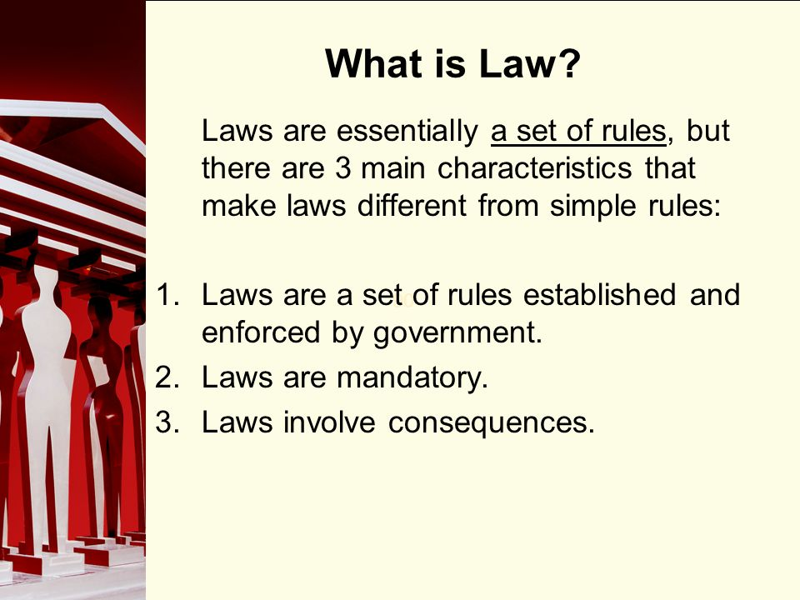


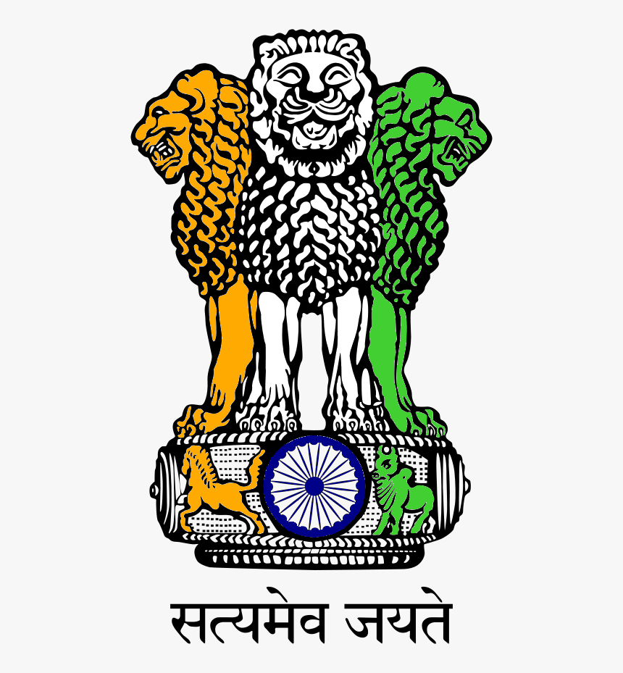


Slide 30
Need for a Constitution
The maxim 'ignorantia juris non-excusat,' or 'ignorance of the law is no excuse, and it is punishable' implies that the Court presumes that every party is aware of the law and hence cannot claim ignorance of the law as a defence to escape liability

Slide 31
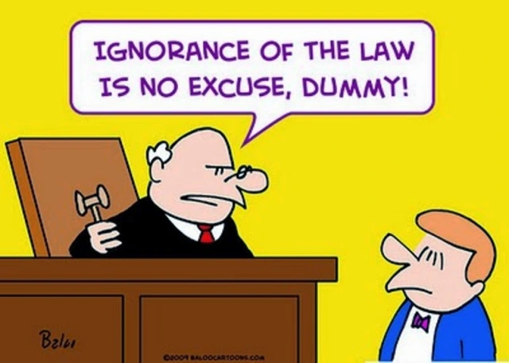

Slide 32
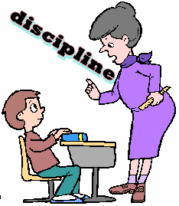
Secular
The term Secular was incorporated in the Preamble by 42nd Constitutional Amendment, 1976 which means that all the religions in India get equal respect, protection and support from the state.
Democratic
The term Democratic implies that the Constitution of India has an established form of Constitution which gets its authority from the will of the people expressed in an election.
Republic
The term Republicâ indicates that the head of the state is elected by the people directly or indirectly. In India, the President is the head of the state and he is elected indirectly by the people.
SET of RULES of a School is called Discipline ******************* SET of RULES of a Country is called Constitution

Slide 33

Household Set of Rules
"Apologize when you're sorry."
"Don't hurt others."
"Tell the truth."
"Treat others fairly.“
"Put your dirty clothes in the hamper basket."
"Share your Laptop with your brother."
"Take turns while playing the game."
“Teach them about money so they can learn how to save and spend money wisely so they are better prepared for paying their own bills as adults.

Slide 34



Protecting the weak from the strong

Slide 35
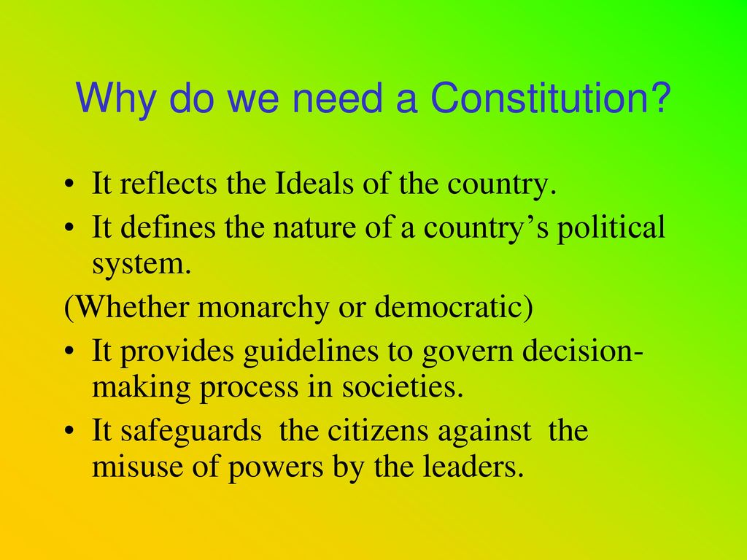

Slide 36
In the words of B.R. Ambedkar,
“Constitution is not a mere lawyer’s document, it is a vehicle of Life, and its spirit is always the spirit of Age.”
In every country, the interests of the citizens must always be given their due weight and must be protected from the arbitrary actions of those in power.
It is crucial for a country to have its sovereignty intact to have political stability.
That is, the relationship between the states and the subjects and also among the subjects, and the subjects should be properly defined.
A constitution is essentially a tool to ensure the political stability of a state.

Slide 37
Indian Constitution
India’s Constitution is the supreme law of India. It defines the Government’s fundamental political values, policies, processes, powers, rights, and duties.
It conveys constitutional supremacy & not parliamentary supremacy because it is not established by the Parliament but by a constituent assembly and adopted by its citizens, with a declaration in its preamble.

Slide 38
About the Indian Constitution
The Constitution of India is the longest Constitution in the world.
It had (395) three ninety-five articles in (22) twenty-two parts and (8) eight schedules at its beginning.
It comprises of around 145,000 words making it the world’s second-largest functioning constitution.
It currently has a preamble, (25) twenty-five parts with, (12) twelve schedules (5) five appendices, (448) four forty-eight articles& (101) hundred and one amendments.

Slide 39
Why do we need a constitution?
It is important to have a Constitution for the following reasons:
It is a significant rule of the nation. The relationship of people with governments is decided by this.
It sets down standards and procedures that are necessary to live in peace for individuals belonging to various religious groups.
It sets out how the government will be chosen and who will have the authority and duty to decide things.
It defines the parameters of the government’s control and informs us about people’s rights.
It reflects the desires of individuals to create a good society.

Slide 40
A set of Rules of a Country is known as the Constitution.
Laws are mandatory means, If an action or procedure is mandatory, people have to do it because it is a rule or a law.
Legal Consequence means, the result of an action that directly or indirectly affects substantive legal rights or obligations. Legal Implications mean, the results or consequences of being involved in something according to the law. A good example is the case of marriage. As a consequence of being married, all property is considered co-owned as long as you acquired it after you got married.

Slide 41




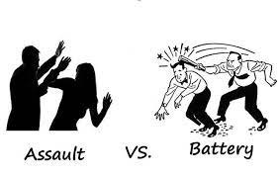
CRIMINAL INTIMIDATION
ROUMORS & GOSSIPS
EVILS of SOCIETY

Slide 42
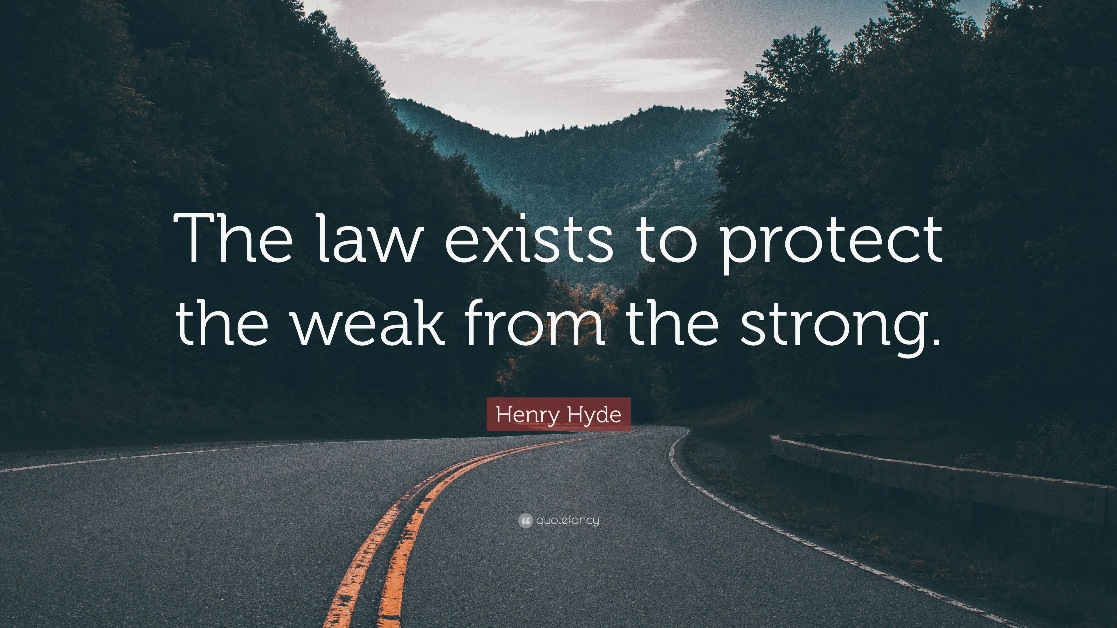


Slide 43
